Slide 1
Nurturing Connections: A Training for Foster and Adoptive Parents Registration Process

Slide 2
Registration for Nurturing Connections training
will be NEW and more intuitive!
Users will access their accounts and take the user profile as they have previously. This sets them up to see courses and curriculums correctly in PDS Online.

Slide 3
Step One: Users will go to PDS Online and search for Nurturing Connections, looking for the stack of books.
Step Two: Users will
select the
appropriate curriculum
for their license.
Notes:
This walks through the handout- be brief, just go give a sense as to the ease of registering, no need to remember as they will get a handout

Slide 4
Step Two: Users will select the appropriate curriculum for their license.
Nurturing Connections Foster Care Level 2 Non-Relative Initial Licensing
Nurturing Connections Foster Care Level 3 Pre-Placement
Nurturing Connections Foster Care Level 4 Pre-Placement
Nurturing Connections Public Adoption
Notes:
These are the titles of all 4 curriculums. For those starting with NC, this is all they need to search for. No need to search for each theme.
Note*if someone started with old curriculum and just need to take some themes as part of the crosswalk, they would not use curriculums. They would need to search for the theme they need and register as we do now.

Slide 5
Step Three: User will request the curriculum
and it will display on their transcript
Step Four: User will click Open Curriculum to see a listing of trainings
Notes:
Demo of handout…….be brief

Slide 6
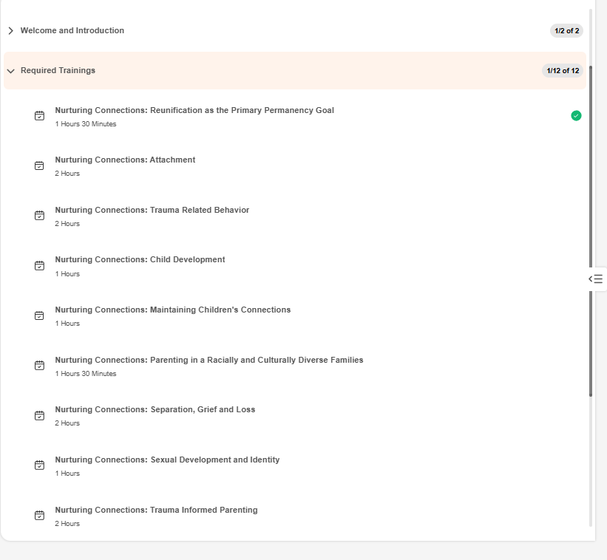
Notes:
Snapshot of what a curriculum looks like on a transcript.
-Welcome and Introduction tab on top when opened would show the pre-req Welcome and Orientation video as well as the form to sign up to have handouts mailed.
-Required trainings shows which of those themes are required depending on license type

Slide 7
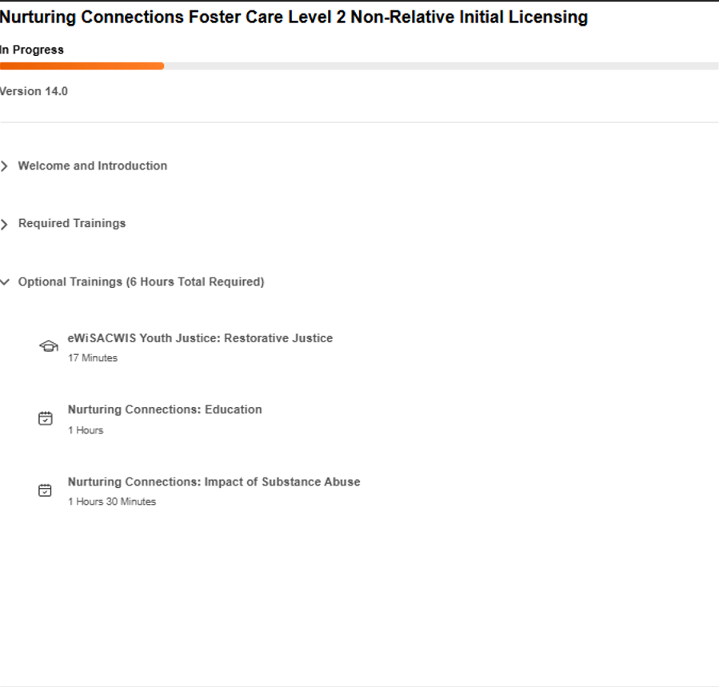
Notes:
Under Required Trainings are Optional Trainings, or electives. This is where they choose themes to complete the number of training hours they need depending on license type.

Slide 8
Step Five: User can register for all trainings directly from the transcript screen. Right Time/On Demand trainings can be accessed and completed directly in the curriculum. Users will have to completed these as individuals for them to count on transcripts (if a couple watches together).
Notes:
From handout

Slide 9
Once completed with all required trainings and the correct hours of optional trainings, the user will take an “exit evaluation” that will denote completion.
Both the user and the licensor will be able to see completions, and track progress via a progress bar:
Notes:
From handout

Slide 10
For those moving to adoption training, all applicable trainings in registered or completed status will move over to the new curriculum, showing the updated progress.
Notes:
From handout. On the left is a curriculum from a L-2 transcript. Green check indicates completion. Right side is the Public Adoption curriculum. You can see that the Attachment theme completed previously populated into the adoption curriculum indicating the parent has that one done. The Reunification theme did not pull over b/c that theme isn’t required for adoption.

