Slide 1
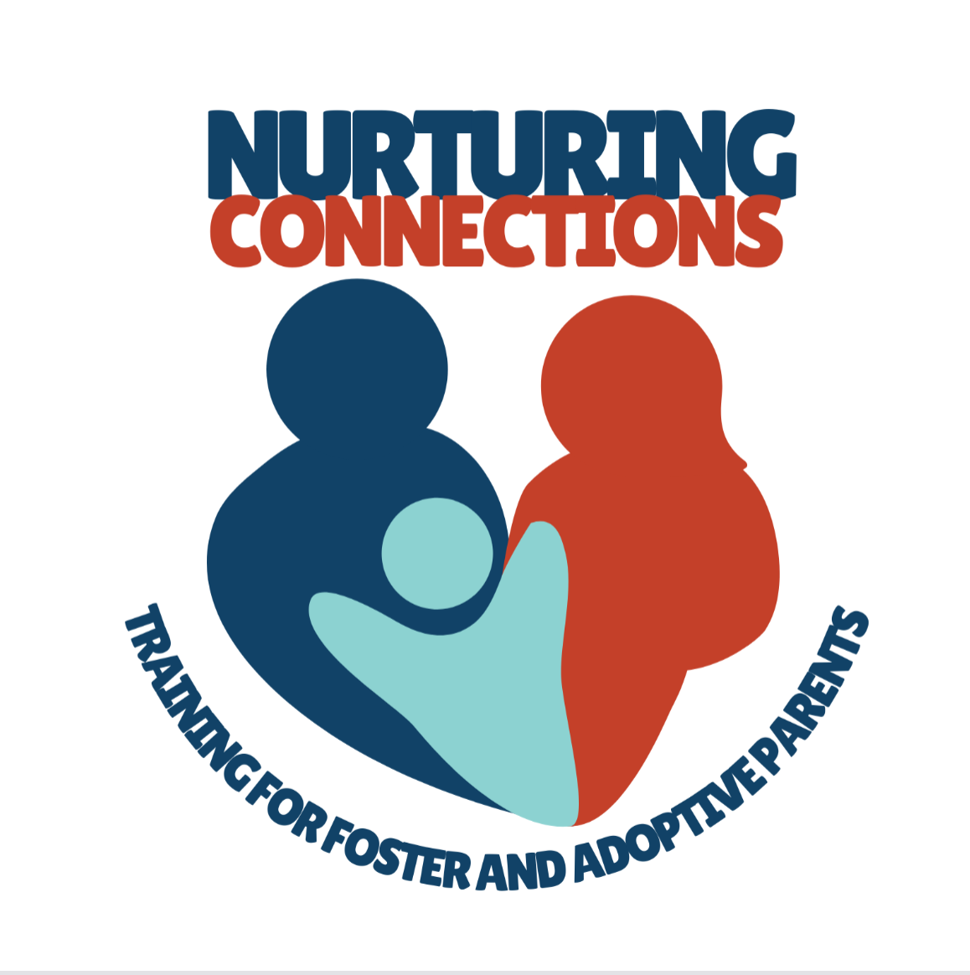
Welcome to Nurturing Connections Training For
Foster And Adoptive Parents

Slide 2
Agenda
Review of Themes
Transition Planning
New Registration
Video Clip Demo

Slide 3
What is Changing
Replaces current curricula:
Foster Parent Foundation
Fostering to Forever
Building Forever Families, Days 1, 2, and 3
Used for:
Level 2 foster parents- initial licensing training
Levels 3 and 4 foster parents- a portion of pre-placement training
All pre-adoptive families- conversion and waiting families

Slide 4
Developed using the National Training and Development Curriculum (NTDC)
A collaborative research-based curriculum led by Spaulding for Children.
Funded by DHHS, Administration for Children and Families, Children’s Bureau
Developed with input from those with lived experience in foster care, including former foster and adoptive youth and resource caregivers.
Incorporates adult learning principles- podcasts, videos, experiential activities which allows parents to practice and develop essential skills
Piloted for 5 years in 8 sites
Extensively and rigorously evaluated with encouraging results.
Designed to be flexible and is easily adapted to meet Wisconsin’s needs
Notes:
Be brief here or skip if covered previously

Slide 5
Nurturing Connections: Training for Foster and Adoptive Parents
Themes vs Modules
Mix of instructor led and on demand (Right Time Training) themes
No class is over 2 hours
Some choice in which classes to take
Spanish language offerings
Notes:
Skip if covered previously. I just like to say how this new curriculum gives us the opportunity to meet needs identified over the last several years.

Slide 6
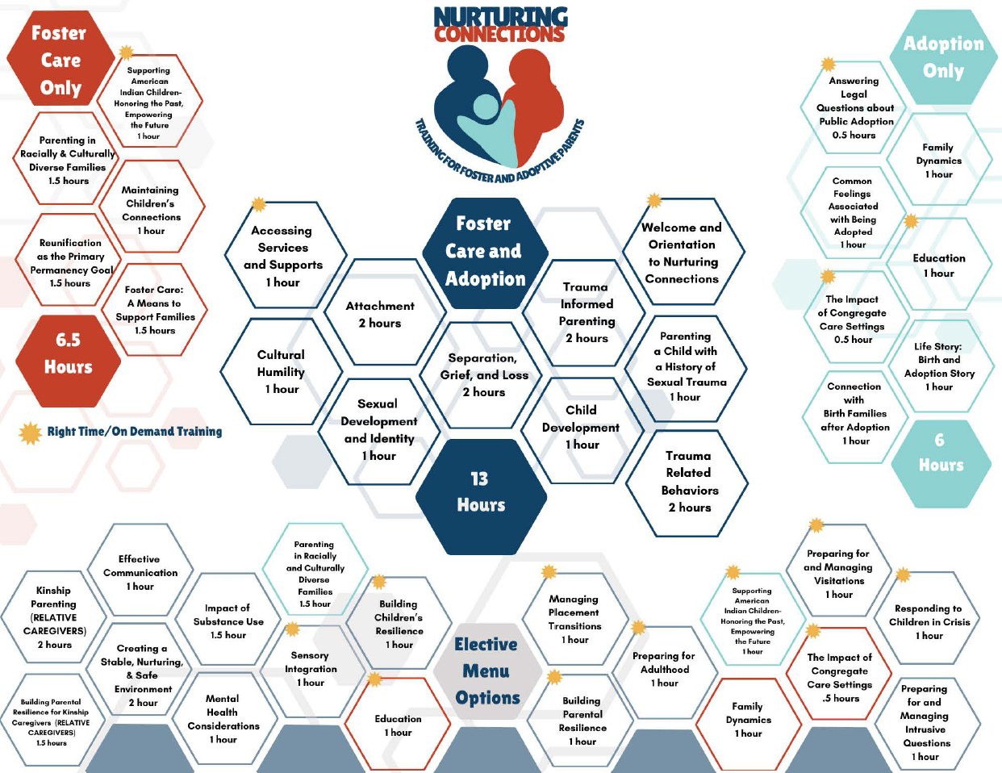
Notes:
This is the entire curriculum. Notice the titles and length of time for each. The themes with yellow stars are Right Time Trainings (On Demand). The rest are instructor led.
Because there are some differences in needs and code, there are some different themes that are only required for foster parents and other themes that are only required for adoptive parents.
-The dark blue middle section all parents are required to take. On the left, in orange, are foster care only required themes and on the right, in light blue are adoption only required themes.
-The Welcome and Orientation in the middle section is a prerequisite to complete before registering for any other theme. It will be about 20 minutes long and no credit given.
-The bottom section are electives to be used for foster parents to reach 30 hours. Adoptive parents have the option to use them for child specific hours.

Slide 7
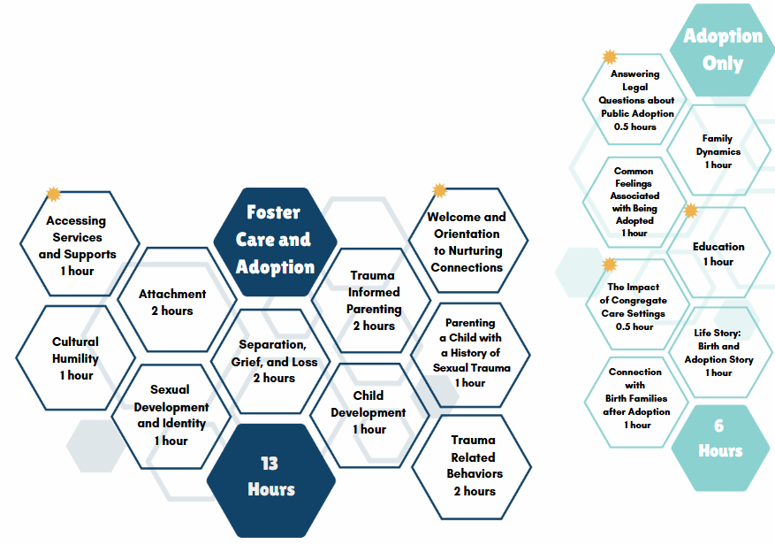
Notes:
-These are the themes in the middle and are required for all parents- foster and adoption, totaling 13 hours. 12 of those hours are instructor led. The Welcome and Orientation is a prerequisite to complete before registering for any other theme. It will be about 20 minutes long and no credit given.

Slide 8
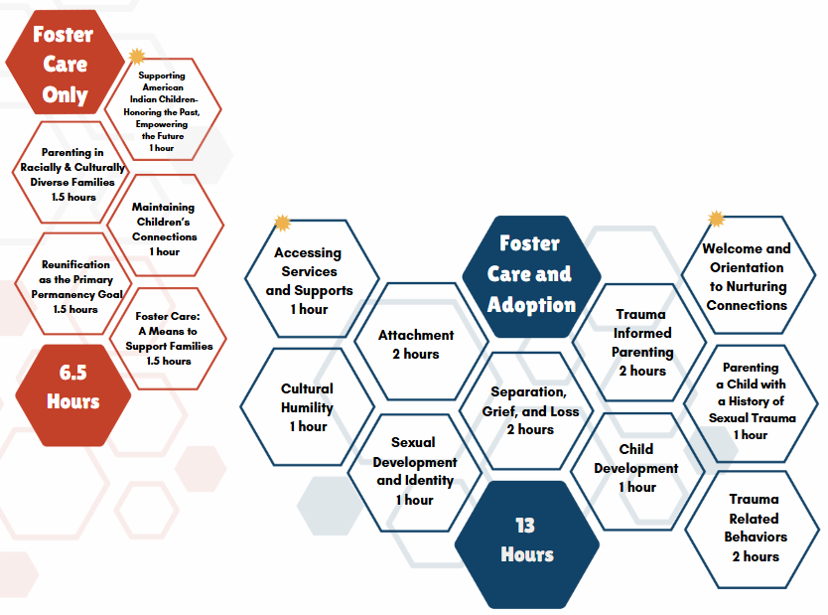
FOSTER CARE REQUIRED
Notes:
These are the foster parent required themes, the dark blue middle section plus the orange one on the left. 19.5 hours. To reach the required 30 hours foster parents will choose from at least 10.5 hours in the electives.
Two themes on the left; Supporting American Indian Children: Honoring the Past, Empowering the Future, and Parenting in Racially and Culturally Diverse Families are not required for adoption, however they are also listed in the electives for adoptive families to choose as child specific training.

Slide 9
Adoption Required Themes
Notes:
These are adoption required themes; the dark blue middle section plus the light blue one on the right. This equals 19 hours, leaving only the 6 hours of child specific training families would need to take. They would have the option of taking electives for those hours. Several of the themes in the right section could be of interest to foster parents; Education, Family Dynamics and The Impact of Congregate Care Settings. These themes are included in the electives to allow foster parents to take them if they choose.
The 4 instructor led themes in that section are designed to be true facilitated discussions around videos and questions.

Slide 10
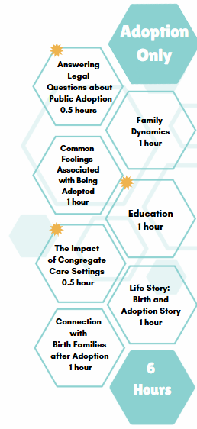
Notes:
The 6 hours of adoption specific themes would be the only requirement (besides child specific) that conversion parents would need as they would have completed the middle section during foster care training. Topics taken during foster care training are not repeated in these themes. The instructor led themes can be tailored towards the needs of participants in each class.

Slide 11
Notes:
Foster parents can choose from these themes to reach their required 30 hours. Adoptive parents can take these for their child specific hours if appropriate.
-Note the 3 themes in orange (Education, Family Dynamics, The Impact of Congregate Care Settings). They are orange to match the foster care only section as they are electives for foster parents. Adoptive parents would not choose these as child specific as they would have already completed them for required hours.
-Note the 2 themes in light blue (Parenting in Racially and Culturally Diverse Families, and Supporting American Indian Children: Honoring the Past, Empowering the Future). They are light blue to match the adoption only section as they can be used for child specific hours by adoptive parents. Foster parents would not choose these as electives as they would have already completed these for required hours.
-2 themes are specifically for relative caregivers! ☺ These are beautifully done and a great option for relative caregivers.

Slide 12
What to Expect
Delivery
Registration
Training of Trainers

Slide 13
TRANSITION PLANNING
August launch
Full roll out by end of September
Families should complete current curriculum before the end of August
Numerous offerings between now and end of August
After August families will have to finish with cross walked Nurturing Connections themes
Flyers, cross walks and other resources are available

